Slide 1
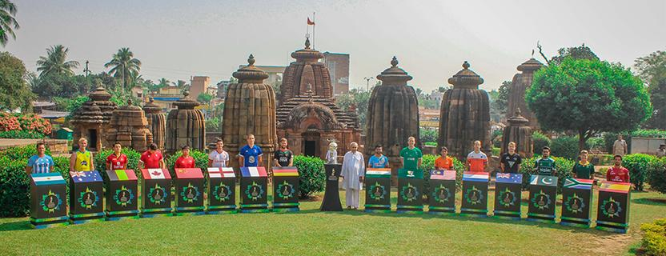

Raj Kumar Mahapatra –Training Manager , India (East)
OSHEC e-resources for Colleges of Odisha - Powered by EBSCO
Faculty Orientation Session In Collaboration with Govt. Autonomous College, Rourkela
26th Feb , 2022

Slide 2


Snapshot of the Session
A Brief Overview
Mobile App Installation (Workshop -10 Min)
EBSCO Solutions Available for OSHEC Members
The EBSCO Advantages
Live Demonstration – Web
Learning Activities: 10 Min
Question & Answers

Slide 3


EBSCO services the information needs of more than 100,000 organizations and tens of millions of users worldwide

Slide 4


EBSCO is the largest provider
of research content to
universities, corporations,
hospitals and the federal government worldwide
40.15 billion page views per year

Slide 5

OSHEC e-Resources for University/Colleges of ODISHA
OSHEC e-Resources for University/Colleges of Odisha is a unique initiative taken by the Government of Odisha to empower the high-quality education and research by providing varied curated content through virtual library facility to all academic users of the state universities of Odisha

Slide 6
Suite of Research Solutions for OSHEC
16,000+ Scholarly Journals & Magazines
200,000+ eBooks
Nearly 2 Million Non-Journal Content
High Quality IF titles ~indexed in Scopus and Web of Science
Remote Access Facility
Mobile App
Dedicated Library Portal
World Renowned Discovery Platform
Notes:
Other Subject Sets released January 2020 not listed in slide:
Aging & Gerontology; American Contemporary Issues; Anthropology & Archaeology; Career; Civil Engineering Economics; Emergency Management; Emergency Medicine; ESL/EFL; Fine Arts; Healthcare Knowledge Management; Leadership & Management; Literary Criticism & Writing; Networking & Security; Pharmaceutical Science; Sports Medicine & Physical Therapy; Vocational Studies

Slide 7


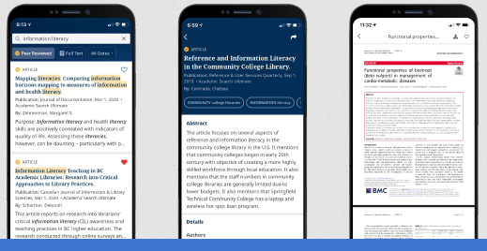
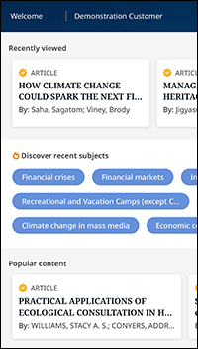
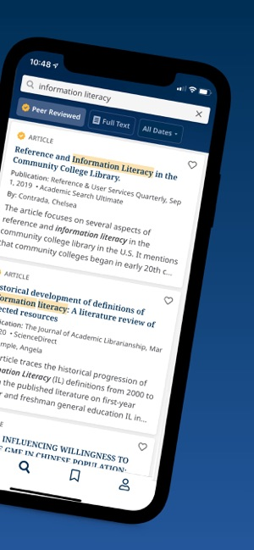



EBSCO Mobile App

Slide 8
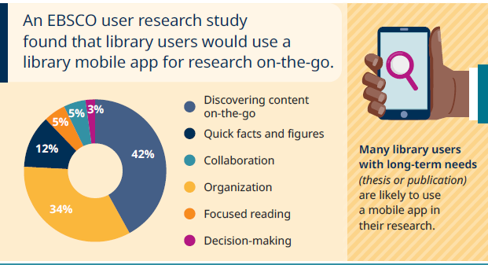
The App Benefits
Search quickly and save articles for later reading
Discover new content based on previous activity
Leverage device technology such as biometric authentication and voice-to-text searching
Keep articles organized with cross-device synchronization
Share with friends using native iOS and Android tools
Read or listen anytime, anywhere
Download and read EBSCO eBooks™

Slide 9



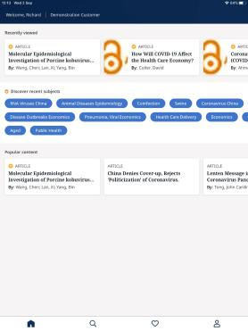

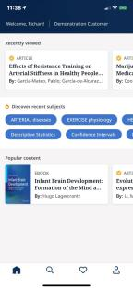

1. Open the App
2. Tap “Get Started”
3. Find your institute
Odisha College Consortium
4. Select and continue
5. Enter your login details as given below:
User ID: odisha_ns330695 Password: odi@ns330695#
Scan the below QR code using your phone to Install the EBSCO Mobile App
Please login for the hands-on experience
Or visit www.onelink.to/ebsco using your phone browser to Install the EBSCO App

Slide 10
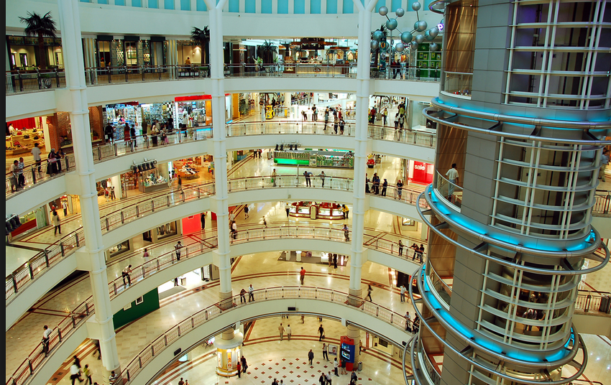

Slide 11


Slide 12

End-User’s Journey with OSHEC e-Resources
Access
Search
Choose
Use

Slide 13
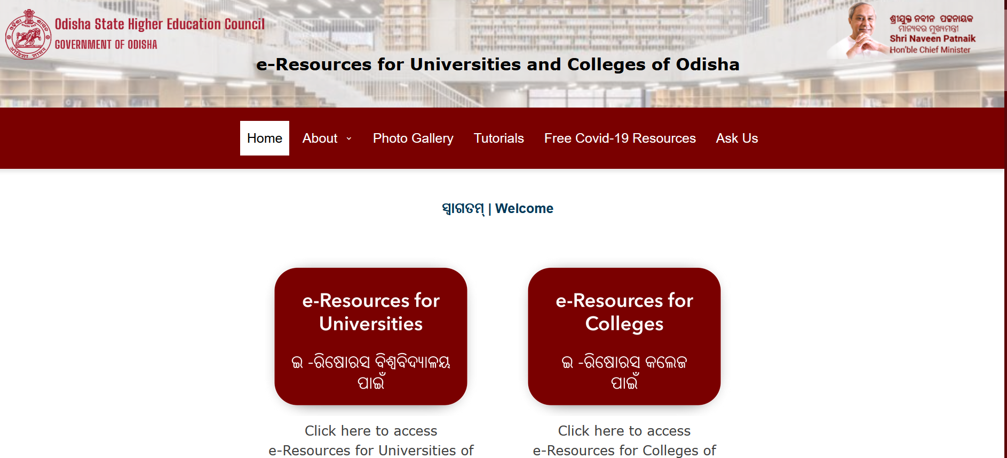
Notes:
A Dedicated Web Page
Most Modern
All in one Approach
Starting Place for research
Easily Identifiable & Integratable
Important News & Updates
Readily Manageable

Slide 14

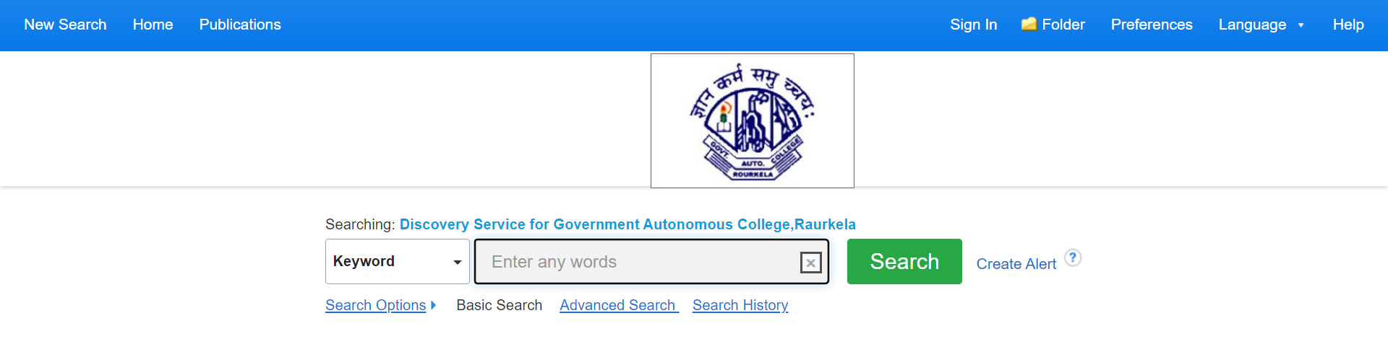
One Platform, millions of research artifacts
Comprehensive Subject Coverage, Largest aggregation of Publishers, Paid & Open Access Content, High Quality Research Content, Multiple Type of Sources
access as you go, at your fingertips

Slide 15
Subject Focus: The Key Ingredient
Anthropology
Arts
Biotechnology
Botany
Business Administration
Commerce
Computer Science
Chemistry
Earth Science
Economics
Environmental Sc
Humanities
Language & Linguistics
Law
Library Science
Literature
Mathematics
Management
Physics
Philosophy
Political Science
Public Administration
Statistics
Zoology
And Many More
Notes:
Other Subject Sets released January 2020 not listed in slide:
Aging & Gerontology; American Contemporary Issues; Anthropology & Archaeology; Career; Civil Engineering Economics; Emergency Management; Emergency Medicine; ESL/EFL; Fine Arts; Healthcare Knowledge Management; Leadership & Management; Literary Criticism & Writing; Networking & Security; Pharmaceutical Science; Sports Medicine & Physical Therapy; Vocational Studies

Slide 16

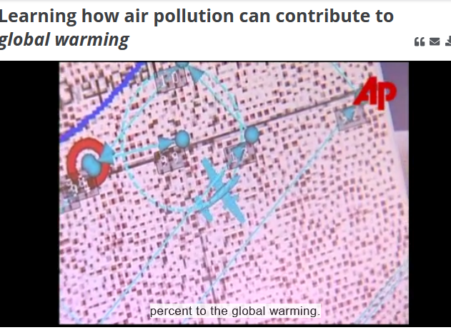





Videos on Several Topics

Slide 17

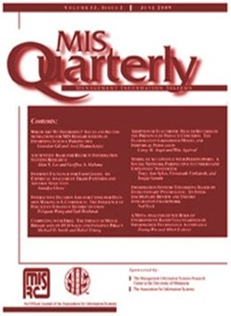

Some of The Noteworthy Journals

Slide 18
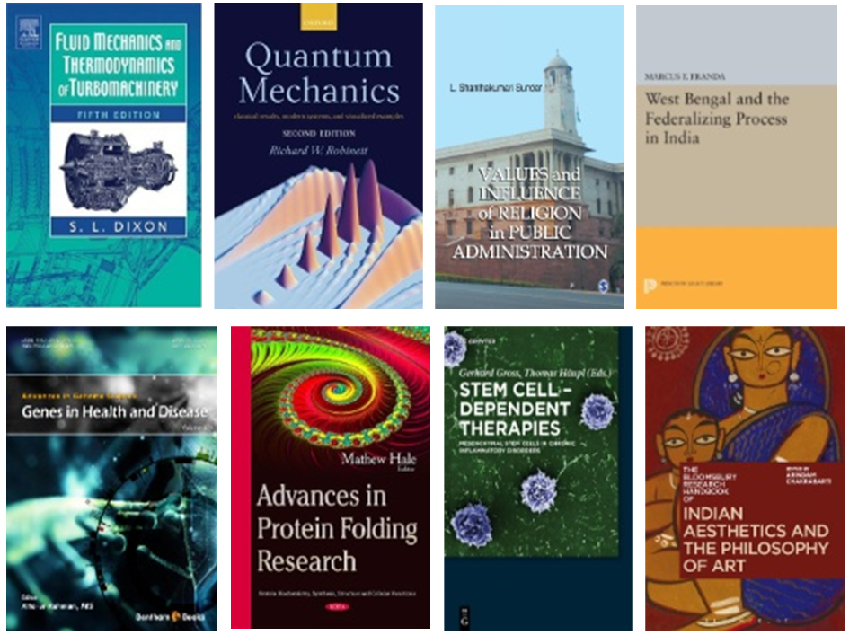


Example of Key eBooks From the Package

Slide 19



Examples of Key Active Full-Text,
Journals Available in the package
International Journal of Quantum Chemistry*
Interpretation: A Journal of Bible & Theology*
Journal of Educational Research*
Journal of Engineering Education*
Journal of Integrative Plant Biology*
*Indicates this title is also unique when compared against all ProQuest and all Gale databases.
November 2020

Slide 20
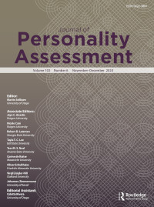


Examples of Key Active Full-Text,
Journals Available in the package
Journal of Personality Assessment*
New Oxford Review
Pennsylvania Literary Journal
Public Health Ethics*
Theory Into Practice*
*Indicates this title is also unique when compared against all ProQuest and all Gale databases.
November 2020

Slide 21
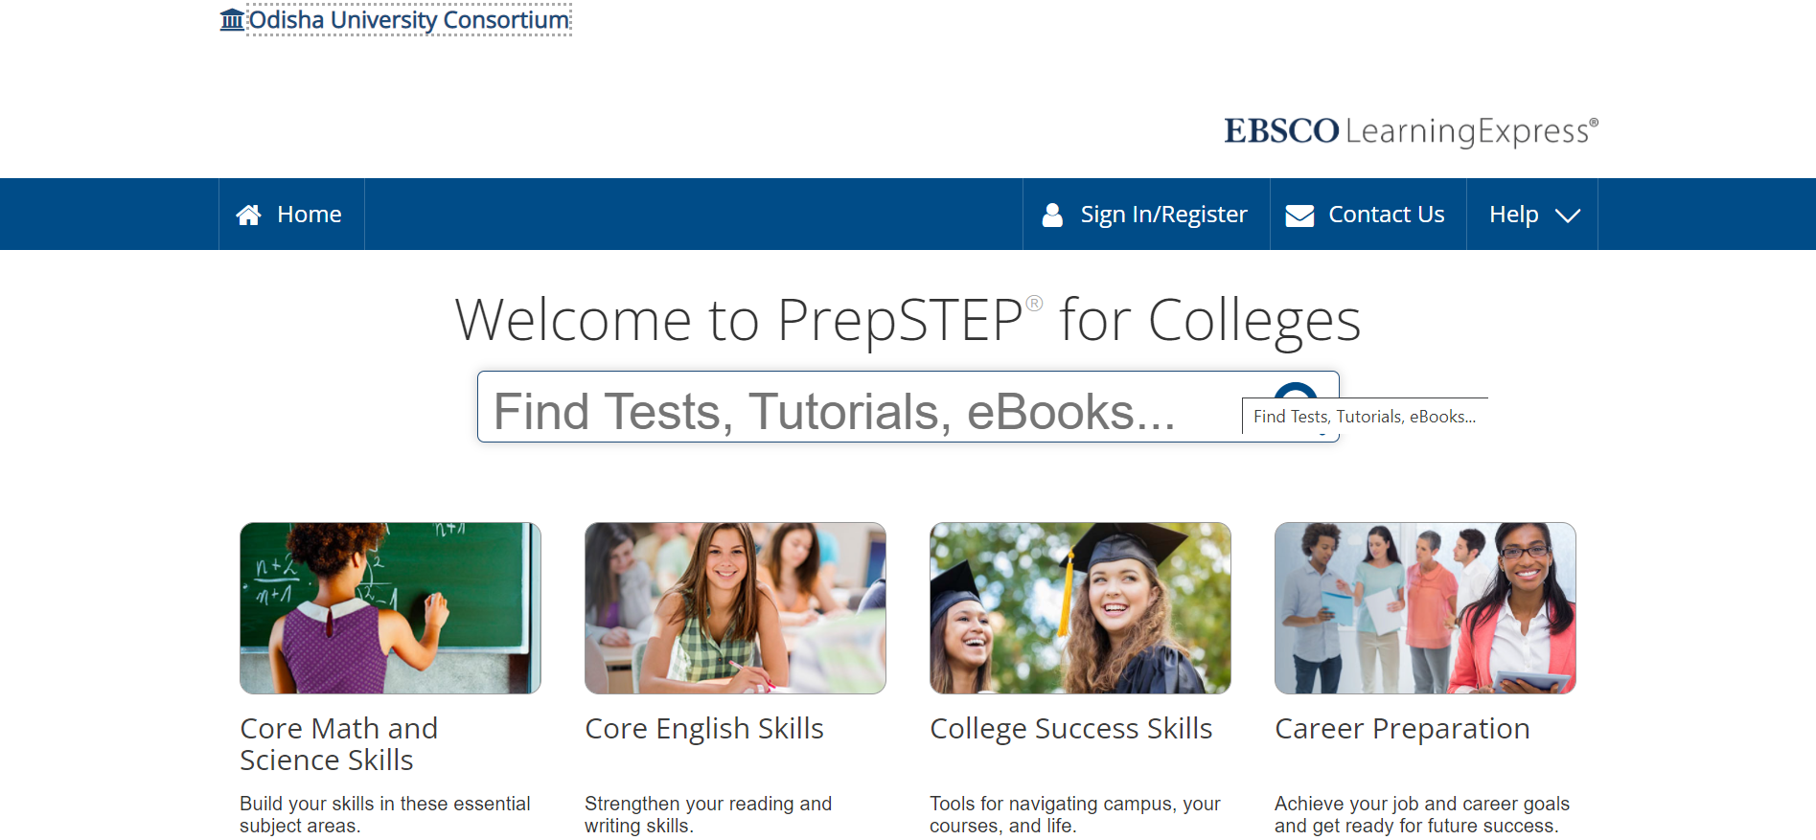
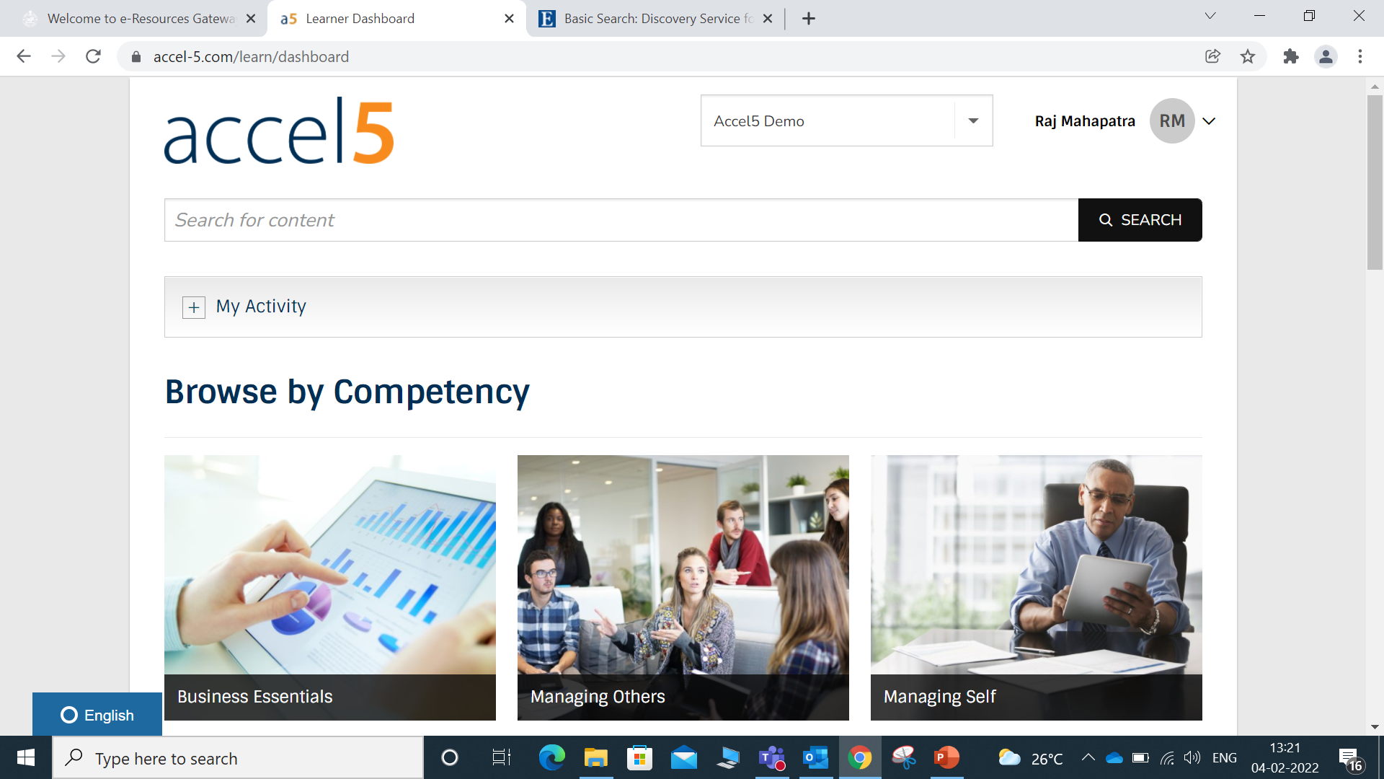
Skill Development Platform Integrated through OSHEC

Slide 22


Slide 23
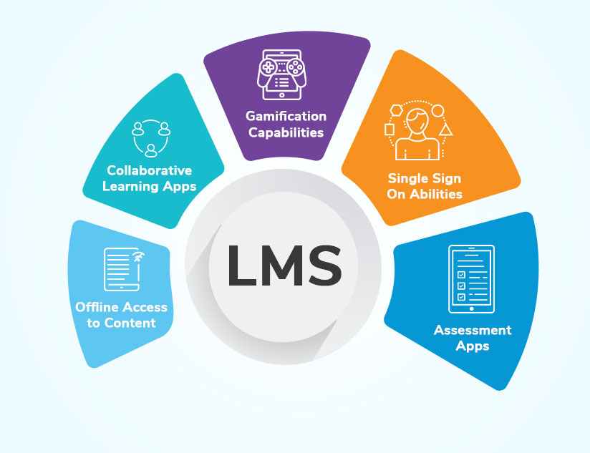




Easy Interoperable Platform

Slide 24
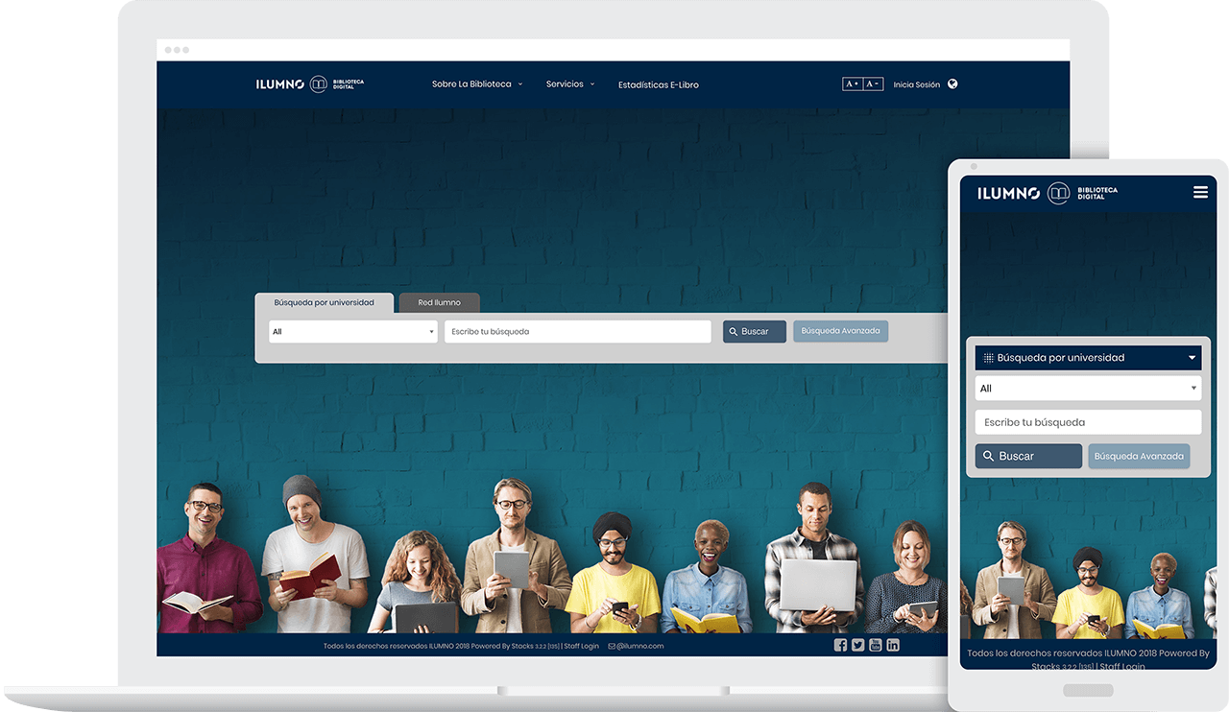
How to Access the OSHEC e-Resources for University/Colleges of Odisha?
https://eresources.oshec.in/college
User ID: odisha_ns330695 Password: odi@ns330695#

Slide 25
Live Demo

Slide 26

Raj Kumar Mahapatra
EBSCO India
Mobile: 8447120140
email: rmahapatra@ebsco.com

